Slide 1
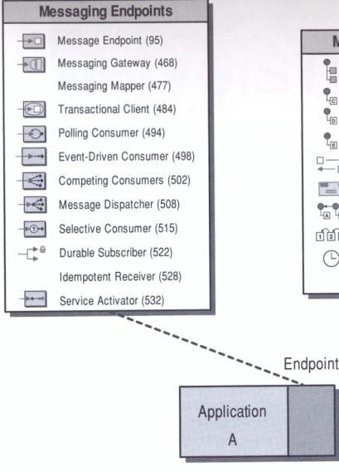

Pattern
Overview
Messaging Endpoints

Slide 2

How to connect to messaging endpoint?
An application connects to a messaging system through …
  Endpoint code you write yourself to a messaging API (e.g. JMS or MSMQ)
  Libraries and tools in commercial middleware packages
We will look at two types of messaging endpoint patterns
  Patterns that relate to both Send and Receive
  Patterns that relate to Message Consumption

Slide 3
Patterns for Both Send and Receive
Encapsulate the messaging code
  a thin layer of code performs the application’s part of the integration Messaging Gateway (468)
Data translation
  Messaging Mapper (477) to convert data between the application format and the message format
Externally-controlled transactions
  Transactional Client (484) to control transactions externally
Messaging Endpoints

Slide 4
Message Consumer Patterns
Some pattern alternatives
Synchronous or asynchronous consumer?
  Polling Consumer (494)
  Event-Driven Consumer (498)
Message grab versus message assignment ?
  Competing Consumers (502)
  Message Dispatcher (508)
Accept all messages or filter?
  Selective Consumer (515)
Subscribe while disconnected
  Durable Subscriber (522)
Idem potency
  Idempotent Receiver (528)
Synchronous or asynchronous service
  Service Activator (532)
Messaging Endpoints

Slide 5
Message Consumer Challenge
Receiving messages is the tricky part!
Throttling: Application ability to control the rate at which it consumes messages
  Consumer can’t control rate at which clients send requests
  Consumer can control the rate at which it processes those requests
    Queue up
    Concurrent message consumers
Messaging Endpoints
Notes:
Any server at risk when high number of clients send requests

Slide 6



Endpoint Concepts in EIP book
Often difficult to tell these concepts apart:
  Endpoint
  Adapter
  Gateway
An message endpoint is a specialized channel adapter custom developed for, and integrated into its application.
A message endpoint should be designed as a message gateway to encapsulate message code
Messaging Endpoints

Slide 7
Send & Receive patterns
Messaging Endpoints

Slide 8

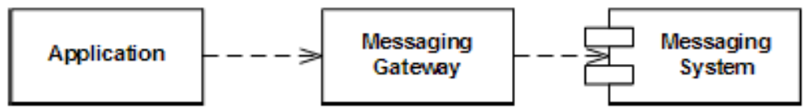
Messaging Gateway
Encapsulates messaging-specific code
Separates it from the rest of the application code
Only Messaging Gateway code knows about the messaging
  Possible to swap out the gateway with a different implementation ☺
Messaging Endpoints
Notes:
Exposes a business function to the rest of the application methods such as GetCreditScore
Provides a domain-specific API

Slide 9
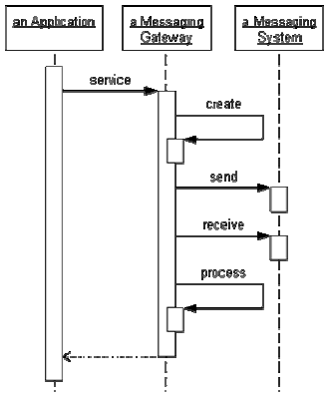
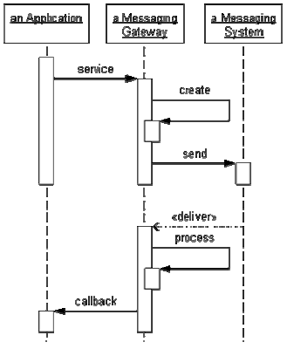
Gateway request-reply example
1.Blocking (Synchronous)
2.Event-Driven (Asynchronous)
Messaging Endpoints
Notes:
Client must provide publicly addressable callback service

Slide 10
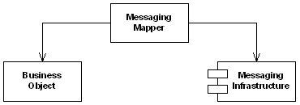
Messaging Mapper (477)
How to move data between domain objects and the messaging infrastructure while keeping the two independent of each other?
Create a separate Messaging Mapper that contains the mapping logic between the messaging infrastructure and the domain objects. Neither the objects nor the infrastructure have knowledge of the Messaging Mapper's existence
Messaging Endpoints
Notes:
Some frameworks like .NET feature built-in object serialization of objects into XML and vice versa.

Slide 11
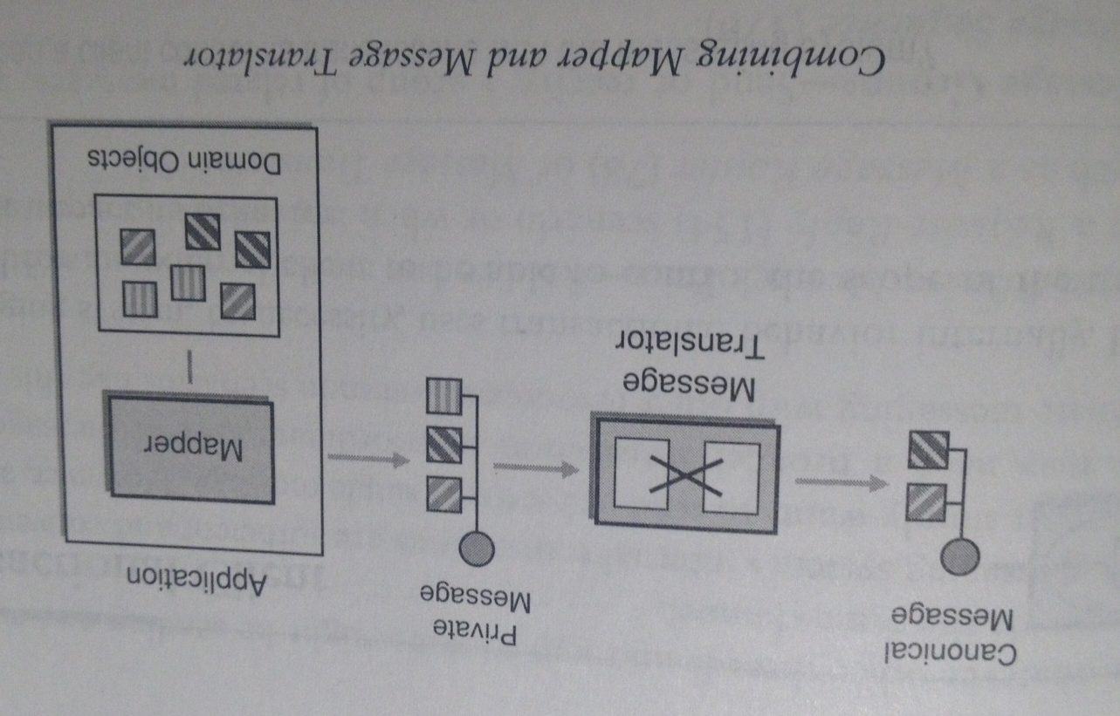
Difference between Mapper and Translator?
Message Translator: Structural mappings inside messaging layer
Messaging Mapper: Object references, data type conversion etc. inside application
Example of combination of the patterns (EIP p. 483):
Messaging Endpoints

Slide 12
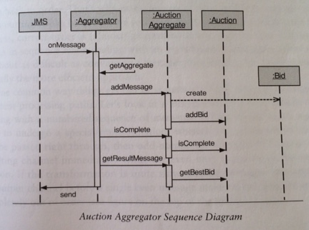
Mapper Example EIP p. 281
ActionAggregate acts as Messaging Mapper that converts between JMS messages and Bid objects
Messaging Endpoints
Notes:
ActionAggregate adapter (280 in text)

Slide 13

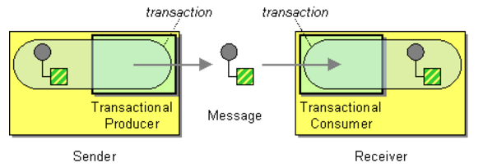
Transactional Client (484)
How can a client control its transactions with the messaging system?
With a sender, the message isn’t “really” added to the channel until the sender commits the transaction.
With a receiver, the message isn’t “really” removed from the channel until the receiver commits the transaction.
Messaging Endpoints

Slide 14
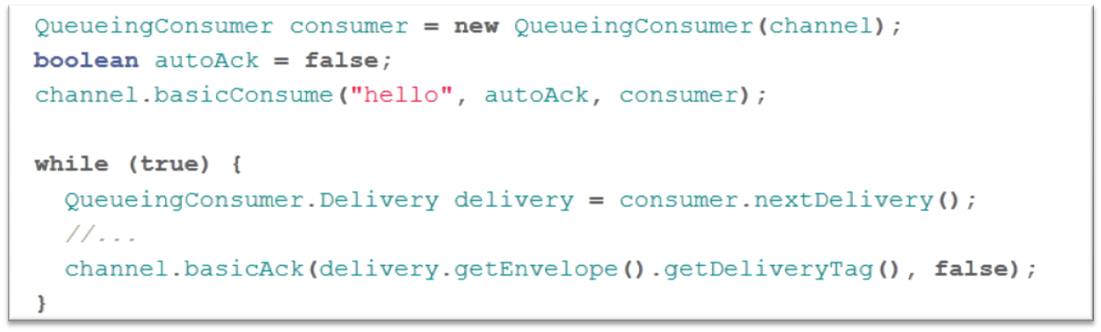
RabbitMQ Example
RabbitMQ supports message acknowledgements
A client makes itself transactional by sending an ack(nowledgement) to tell RabbitMQ that a message has been received, processed and RabbitMQ is free to delete it
Message acknowledgments are turned on by default.
We must explicitly turned them off via the autoAck=true flag
Messaging Endpoints
Notes:
If a consumer dies without sending an ack, RabbitMQ will understand that a message wasn't processed fully and will redeliver it to another consumer.

Slide 15
Consumer patterns
Messaging Endpoints

Slide 16

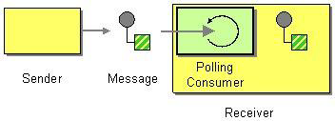
Polling Consumer (494)
A polling consumer actively checks for new messages to consume
A polling consumer won’t poll for more messages until it has finished processing the current message, i.e. when it is ready!
Messaging Endpoints

Slide 17
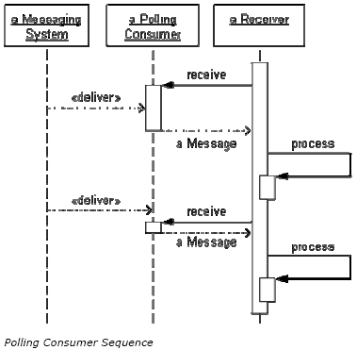
Polling Consumer Flow - Example
Synchronous receiver receives messages by explicitly requesting them
receive method blocks until a message is delivered
Application can control how many messages are consumed concurrently (by limiting no. of threads that are polling
Extra messages queue up until receiver can process
How the consumer gets the message from messaging system is implementation specific
Messaging Endpoints

Slide 18

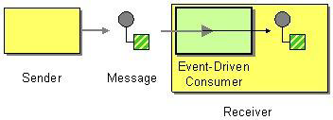
Event-Driven Consumer (498)
An Event-Driven Consumer listens on a channel and waits for a client to send messages to it.
When a message arrives, the consumer ‘wakes up’ and takes the message for processing
Messaging Endpoints

Slide 19
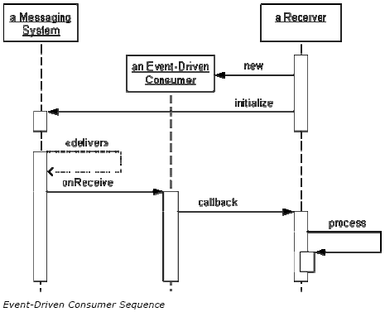
Event-Driven Consumer Flow - Example
Asynchronous receiver is invoked by messaging system when a message arrives
Consumer passes message to application through callback
Consumer must be associated with specific channel
Consumer is idle between messages waiting to be invoked
Messaging Endpoints

Slide 20

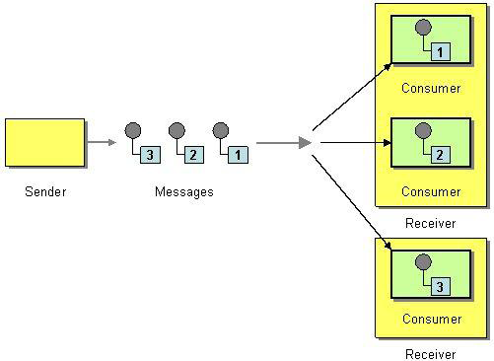
Competing Consumers (502)
Creating multiple Competing Consumers on a single channel make the consumers process multiple messages concurrently
  When the channel delivers a message, any of the consumers could potentially receive it
  In effect the consumers compete to be the receiver
  The messaging system's implementation determines which consumer actually receives the message
Notes:
Rabbitmq – normal produce-consume on p-t-p, but with fetch_size = 1
Each Competing Consumer runs in its own thread, so they all can consume messages concurrently

Slide 21

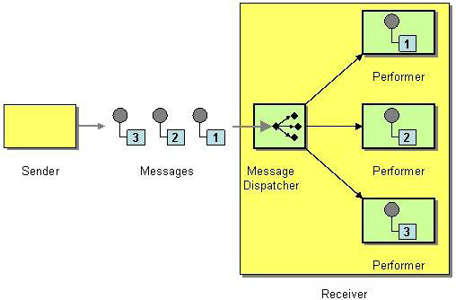
Message Dispatcher (508)
How can multiple consumers on a single channel coordinate their own message processing?
A Message Dispatcher will consume messages from a channel and distribute them to performers
The client implements the coordination itself (as opposed to competing consumers)
Messaging Endpoints
Notes:
The coordination of competing consumes depend on the messaging system. If the client wants to implement the coordination itself, it should use a Message Dispatcher.
Selective Consumer is alternative , but may not support selection based on values in the body of message.

Slide 22
Message Dispatcher 2
Consists of two parts:
  Dispatcher: consumes messages from a channel and distributes each message to a performer
  Performer: is given the message by the dispatcher and processes it.
If the performer processes in its own thread, the dispatcher can receive and delegate other messages, so they can be consumed as fast as the dispatcher can receive and delegate them
Messaging Endpoints

Slide 23

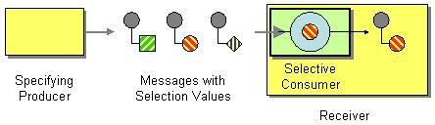
Selective Consumer (515)
How can a message consumer select which messages it wishes to receive?
Make the consumer a Selective Consumer, one that filters the messages delivered by its channel so that it only receives the ones that match its criteria
Messaging Endpoints

Slide 24
Selective Consumer Filtering Process
Three parts to the filtering process:
  Specifying Producer. Specifies the message’s selection value before sending it
  Selection Value. One or more values specified in the message that allow a consumer to make the selection
  Selective Consumer. Receives messages that meet its selection criteria
Messaging Endpoints

Slide 25
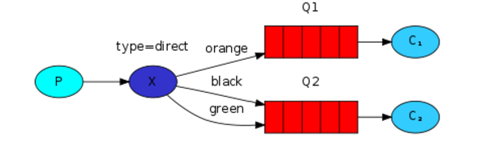
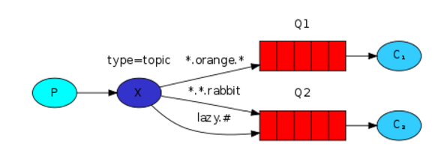
RabbitMQ Exchange Examples
Direct exchange example:
Topic exchange example (more fine-grained routing key)
Messaging Endpoints

Slide 26
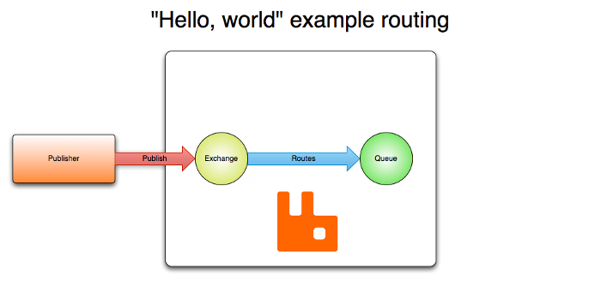

No consumer on channel?
RabbitMQ: Exchange without Queue
If there are no queues bound for an Exchange at the time of publishing a message,
the message will be discarded
RabbitMQ

Slide 27
Selective Consumer Considerations 1
Selective Consumers makes a single channel act like multiple Datatype Channels
This might not be a good approach (design)
  Msg. system doesn’t authorize consumer’s selection → malicious consumer might gain access to unauthorized messages
  It can conserve channels in an enterprise that requires more channels than the messaging system can support
Messaging Endpoints

Slide 28
Selective Consumer - Alternatives
Selective consumer vs. Message Dispatcher?
  You want msg. system to do dispatching (Selective Consumer)
  You want to do it yourself (Message Dispatcher)
Selective consumer vs. Message Filter?
  Same goal, but different ways
    Selective consumer: all messages are delivered to the receivers, but each receiver ignores unwanted messages. It allows unwanted messages to be available to other receivers
    Message Filter: Sits between sender channel and receiver channel and only transfers desired messages to the receiver’s channel. Undesired messages are eliminated from channel
Messaging Endpoints

Slide 29
Selective Consumer Considerations 2
A Selective consumer can be implemented as Polling Consumer or Event-Driven Consumer.
It can be part of Transactional Client
To implement the filtering behavior yourself, use Message Dispatcher
Messaging Endpoints

Slide 30

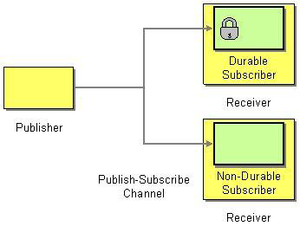
Durable Subscriber (522)
How can a subscriber avoid missing messages while it’s not listening for them?
Use a Durable Subscriber to make the messaging system save messages published while the subscriber is disconnected
Messaging Endpoints

Slide 31
Durable Subscriber 2
Message system saves messages for an inactive subscriber
Delivers these saved messages when the subscriber reconnects
Subscriber will not loose any messages even though it disconnected
A connected subscriber acts the same whether its subscription is durable or non-durable
The difference is in how the messaging system behaves when the subscriber is disconnected
Messaging Endpoints

Slide 32
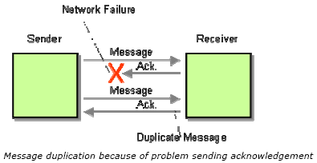
Idempotent Receiver (528)
How can a message receiver deal with duplicate messages?
Design a receiver to be an Idempotent Receiver, one that can safely receive the same message multiple times
Messaging Endpoints

Slide 33
Idempotent Receiver 2
Can be achieved through two primary means
Explicit removal of duplicate messages
  We must keep track of messages already received
  How long to keep this history?
  Must we persist it?
Define message semantics to support idempotency
  E.g. resend the message so it does not impact the system,
  Instead of
      Add $10 to account 1234
  Use
      Set balance of account 1234 to $110
Messaging Endpoints

Slide 34

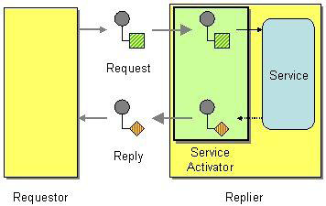
Service Activator (532)
An application designs a service to be invoked both asynchronously (via messaging) and synchronously (RPC technique)
  A Service Activator connect a message channel to the synchronous service in an application. When a message is received, the service is invoked (the service doesn’t know it’s being invoked through messaging)
Messaging Endpoints

